Slide 1
Nursing Onboarding Resource Guide Training For Preceptors, Educators and Nurse Leaders
Facilitators: Lisa Smith and Randy McClain
July 7, 2021
Notes:
Notes testing

Slide 2
Objectives
Review dates for upcoming training sessions
To provide an overview of current state (Preceptor Toolkit) and future state(Preceptor Resource Guide)
To understand Wellstar’s Professional Practice Model and its impact on onboarding nurse professionals
Review roles and responsibilities for preceptor, educator, nurse leader, and orientee
To understand clinical onboarding and orientation
To review forms, workflow and other resources used during orientation

Slide 3
Dates for Training
July 07, 2021 5:30-6:30 p.m..
July 9, 2021 7:00-8:00 a.m.
July 13, 2021 5:30-6:30 a.m.
July 15, 2021 12:00-1:00 p.m.
July 21, 2021 12:30-1:00 p.m.
July 19, 2021 4:00-5:00 p.m.
Notes:
We are offering multiple one-hour sessions for education on use of the Nursing Onboarding Resource Guide for your convenience on the following dates:
For those who are unable to attend a live Teams meeting. An on-demand option will be available via E-source, on the Center for Nursing Excellence page
This is a good time to show them
E-source
CFNE site
Nursing Onboarding Resources (on left side navigation section)
Not only do we have a copy of the resource guide here, but there are links to the forms and resources such as the RN Weekly evaluation form, ICA, Preceptor Evaluation Form and Precepting page for those interested in taking the Preceptor training class. This is where we will post the link to the on-demand training

Slide 4
Onboarding, Orientation, and Precepting
Current State
Future State
Turnover in staff and Managers due to Covid
Lack of participation in formalized preceptor training
Limited Number of preceptors
Many forms and Resources
Inconsistent process for orientation and precepting
Limited preceptor recognition
Lack of ongoing professional development
Anticipate Highest number of new graduate hires since Covid
Provide just in time training resources and education
Increase Preceptor pool utilizing nurses completing residency
Localize forms needed for Orientee and Preceptor
Provide opportunities for preceptor recognition and financial incentive
Notes:
In case there are questions related to TSAM we can talk to this is rolling out system wide, by specialty service and until the entire organization is transitioned THIS resource guide will provide valuable resources to assist as we have an unprecedented number of new hires that we are welcoming into the organization. As TSAM is implemented by specialty the ICAs are being updated, so we will continue to use the current forms found in this resource guide until that time your specialty service transitions.
When asked questions related to Preceptor Recognition here are some talking points:
We currently have some incentives in place for preceptors, such as a recognition celebrations, and preceptor pay. However, we recognize there is opportunity to improve upon these and there are committees such as the Preceptor Advisory Counsel) working with leadership to improve upon what we currently have in place. More to come (Randy please feel free to provide more context as appropriate here)
Note: (Just in time training is being created and it’s going aimed at providing a one-page comprehensive reference sheet that will use some of the info from this resource guide)

Slide 5
Why have an Orientation and Onboarding Program?
Purpose: Orientation and Onboarding helps us cultivate an environment of inclusion and interprofessional collaboration
Objectives: To attract, retain and develop a vibrant workforce that promotes engagement, trust and ownership.
Benefits
Reduces variation in practice, increases process standardization
Decreases stress for preceptors and new evidence-based practice users
Improves preceptor skills
Builds on Benner’s Novice-to-Expert Theory
Creates a skilled preceptor pool
Increases staff QI initiative involvement
Boosts collegiality
Source: Sigma Nursing Repository

Slide 6
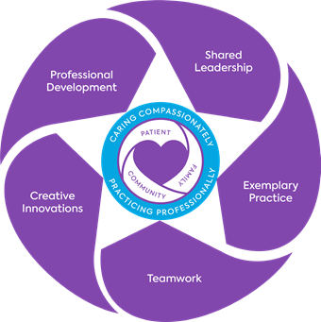
Wellstar Professional Practice Model
The Professional Practice Model (PPM) guides nursing the preceptor’s practice as demonstrated through Teamwork as you partner with the nurse preceptee, interdisciplinary partners, educators, and leaders.
Shared leadership and professional development
How can we allow our preceptees to demonstrate competency?
How can we promote critical thinking in our preceptees?
Source: CFNE Intranet (PPM Shared Leadership Model)
Notes:
Shared leadership and professional development are demonstrated through shared decision-making We value input, and every voice is heard.
When evaluating the Orientee’s progress, the team (NL, educator, orientee and preceptor) collectively decide how to provide a clinical or educational experience that aids in closing a skill or knowledge gap.
Remember we want you to provide your orientee opportunities to shadow as they become available on the unit. By exposing them and allowing them to return the demonstration are keyways to promote confidence.
Also, although you are busy take time out to discuss the plan at the beginning of each shift, so you have a blueprint moving forward.
We all know and understand throughout the day priorities might change but this will help the orientee:
get organized
understand expectations
allow them to verbalize what they need
and sets clear expectations
Also, ask questions to get them to connect the dots from critical thinking perspective, i.e. the significance of a particular lab value, vital sign and tie into medication administration .
Remember, this new graduate cohort has had minimal clinical exposure secondary to the pandemic and are feeling very uncertain and nervous.
YOU ARE SO IMPACTFUL in their initial exposure to professional nursing and can have a great deal of influence.

Slide 7
Wellstar Onboarding Overview
System Orientation
New Team Member Orientation
Clinical Orientation
Nurse Residency Program (NRP)
12 Sessions
Clinical Reflections
Small Group
Graduation/ Celebrations
Specialty
Fellowship Sessions
Acute Care
Critical Care
Emergency
Women’s
Perioperative
Facility Orientation
Competency Assessment
Assigned Preceptor(s)
Review of progress
Cath Lab/CARU
Notes:
System Orientation- NEO, Completion of CBL’s (Org Learning assigns these), and includes EPIC training
Facility Orientation – getting
NRP –for all new graduates and nurses with < 6 months experience as Nurse Professional
Program is 1 full year in length
Resident is expected to complete all program requirements
Attendance in classes and small groups is required
Evidence based project completion is mandatory
Specialty Fellowships – Residents are automatically enrolled. For transitioning nurses (which are considered as experience nurses, > 6 months of experience that are new to a specialty service)- their hiring manager/unit leader/educator must provide the approval, adjust the schedule and assist with registration for fellowship classes. These classes are to support nurses into the new specialty area

Slide 8
Roles and Responsibilities
Orientee | Preceptor | Nurse Leader
Provides contact info Preceptor and Nurse Leader Identify and communicate self-learning needs Confirms schedule with Nurse Leader and Preceptor Take initiative to seek opportunities for learning and increasing skill proficiency Complete onboarding forms and submit to Nurse Leader Attend all Residency, small group and Fellowship classes Complete all CBLs and evidenced- based projects Provides feedback and communicates concerns to preceptor and/or Nurse Leader | Provides contact info and shift schedule to orientee Familiarizes orientee to unit, staff, P&P, and processes Partners with RN to assess current knowledge and skill level Provides and reviews onboarding forms for orientation i.e.. ICA Meets with orientee each shift to provide goals for the day, set learning objectives, and encourages critical thinking Provides positive and constructive feedback Coordinates weekly meetings Gradually increases patient loads based on orientee’s progress Provides feedback to Nurse Leader on Orientee’s progress throughout orientation period | Review roles of preceptor selection to determine appropriateness to support new hires Assigns preceptor to new hire and communicates name and contact information to Meets with preceptor prior to new hire arrival to create orientation plan/schedule Meets with preceptor and orientee bi-weekly to discuss progress Monitors competency completion Facilitates one on one leader rounding Ensures orientee attends all residency and specialty fellowship sessions as assigned Sends copy of all completed orientation/onboarding paperwork to HR
Notes:
Per Natalie -We will probably spend some time on this slide as there has been some ambiguity on roles/responsibilities, as well as a number of new Managers/Preceptors etc.

Slide 9
Onboarding Workflow
Notes:
We will spend some time on this workflow. We understand that there may be some facility or even unit specific variables as to who is designated in these roles and has ultimate responsibility, however, from a system-wide perspective this work-flow provides context to the overarching expectation of how the new hire is guided through the orientation process.

Slide 10
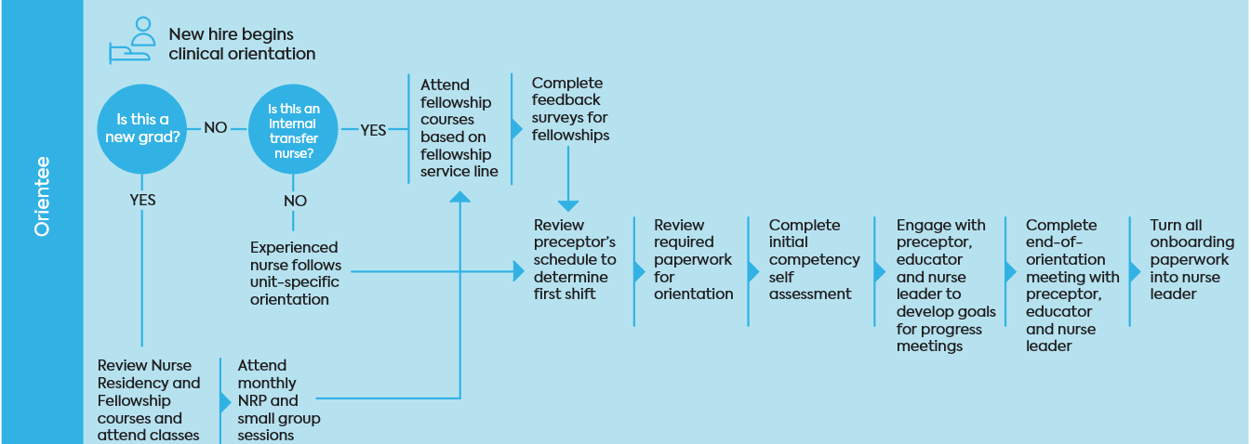
Orientee
Notes:
NOTE: Under the flow is this a new grad- YES-Review residency and Fellowship courses and attend classes- the flow goes down to Nurse Residency Coordinator ( which you do not see here- Nurse Residency Coordinator contacts the new grad with schedule/expectations
Is this an internal transfer nurse –Yes- this is most likely a transitioning nurse moving from one unit specialty to another

Slide 11
Preceptor

Slide 12
Nurse Leader (CN/NM/CNL)
Notes:
Note: with this process flow when you get to the decision circle “IS THE NEW HIRE PROGRESSING- IF NO THE FLOW GOES DOWN TO HUMAN RESOURCES- The Manager will work with local HR leader to review progress and evaluate options

Slide 13
Nurse Educator
Notes:
The “NO” is a decision tree off of the Nurse Leader workflow that goes down to HR. this is not a “No” for the nurse educator

Slide 14
Nurse Residency Professional Development and Retention Specialist
Notes:
Retention Specialist may have more involvement in orientation/onboarding based on facility/unit work flow process

Slide 15
Human Resources
Notes:
HR works with Nurse Leader to evaluate options when new hire is not progressing.

Slide 16
Onboarding Forms
Initial Competency Assessment (ICA)
RN Onboarding Weekly Evaluation and Needs Assessment
Preceptor/Orientation Evaluation Form
Notes:
ICA is Wellstar’s competency assessment. Every clinical role has competencies that the orientee must demonstrate by the end of their initial six month period. This document provides the orientee an opportunity to identify self assessed needs, as well as provides the preceptor a place to document validation of competency completion
TSAM- uses Nurse Orientation Record- this is the new ICA
RN Weekly Onboarding Form – the orientee and preceptor should review and complete this form at the end of the week to establish goals for the next week.
Preceptor Orientation evaluation - this form is completed by the orientee to provide feedback on Preceptor and orientation experience. Feedback is used to improve the onboarding and orientation process. This form is given to the nurse leader at the end of the orientation period.
THE NURSE LEADER IS RESPONSIBLE FOR COLLECTING ALL FORMS AND FORWARDING TO HR UPON COMPLETION OF ORIENTATION

Slide 17
Additional Resources
Role of Preceptorship
Seven Roles of Preceptor
Six Principles of Adult Learning
Notes:
Roles of Preceptor are inclusive of but not limited to:
Teacher/Coach: Expands Knowledge
Sharing of Expertise
Connecting Theory to Practice
Giving Examples
Leader/Influencer: Values Altruism
Promotes Autonomy
Preserves Human Dignity and Integrity
Facilitator: Provides positive/safe environment
Non-Threatening
Open to Questions
Sharing Experiences
Evaluator: Feed back is Timely
Balanced (Goal Focused & Constructive)
Private
Consistent
Equal
Social Agent: Transition to new role
Integration to new environment
Sharing unwritten rules
Role Model: The preceptor most be self-aware of verbal and non-verbal behavior
Protector: Developing coping skills (***preparation)
Managing difficult situations
Removes from workplace incivility
Gives them skills for beyond the orientation period

Slide 18
Questions

